Slide 2
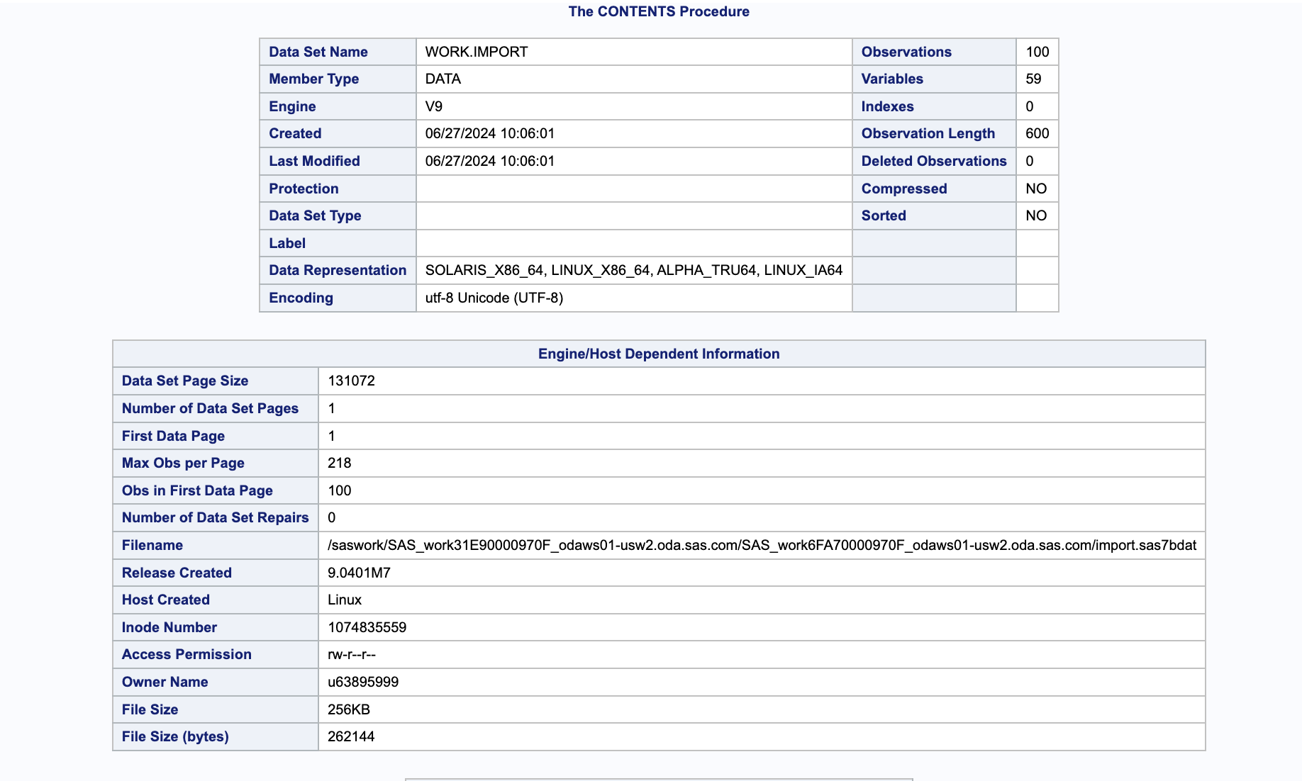
Description of the data

Slide 3
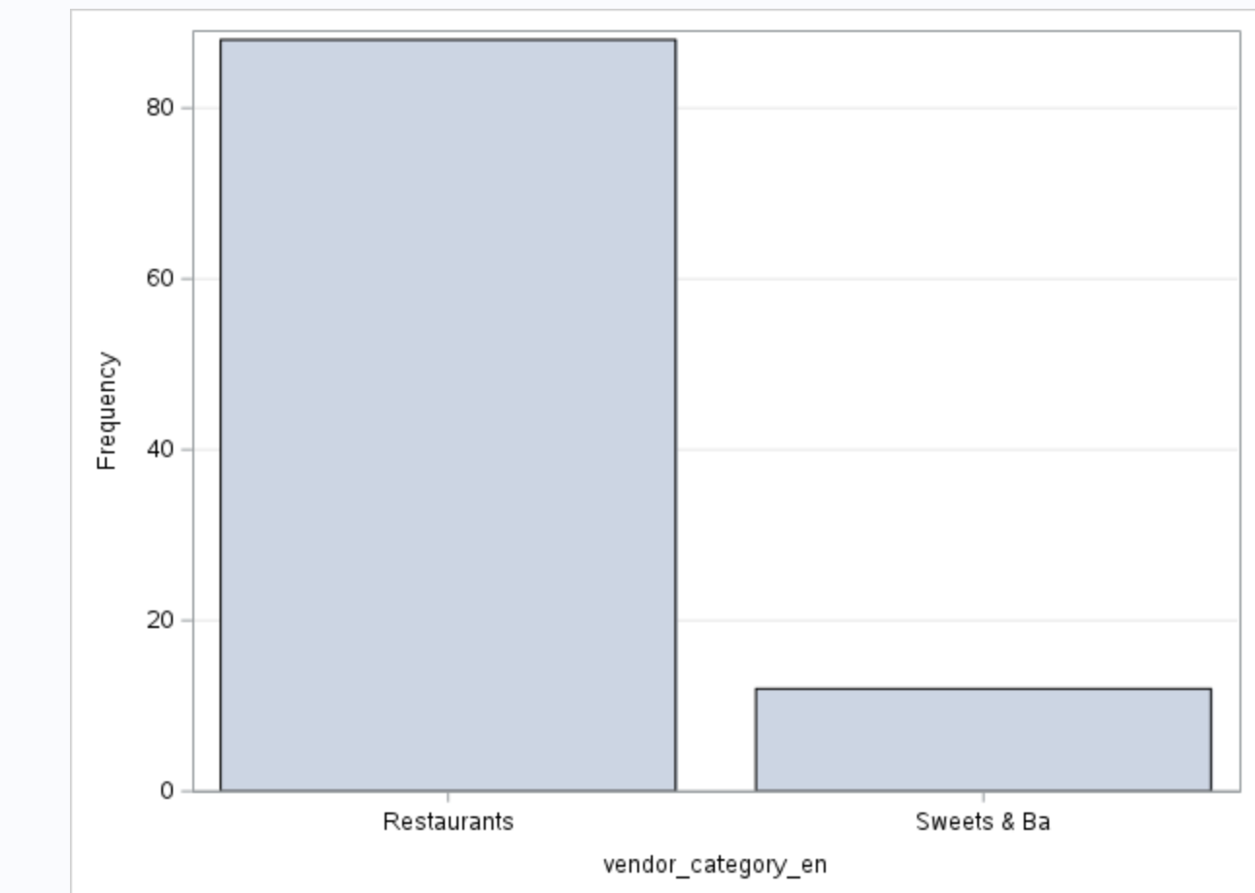
Count of Vendors category

Slide 4
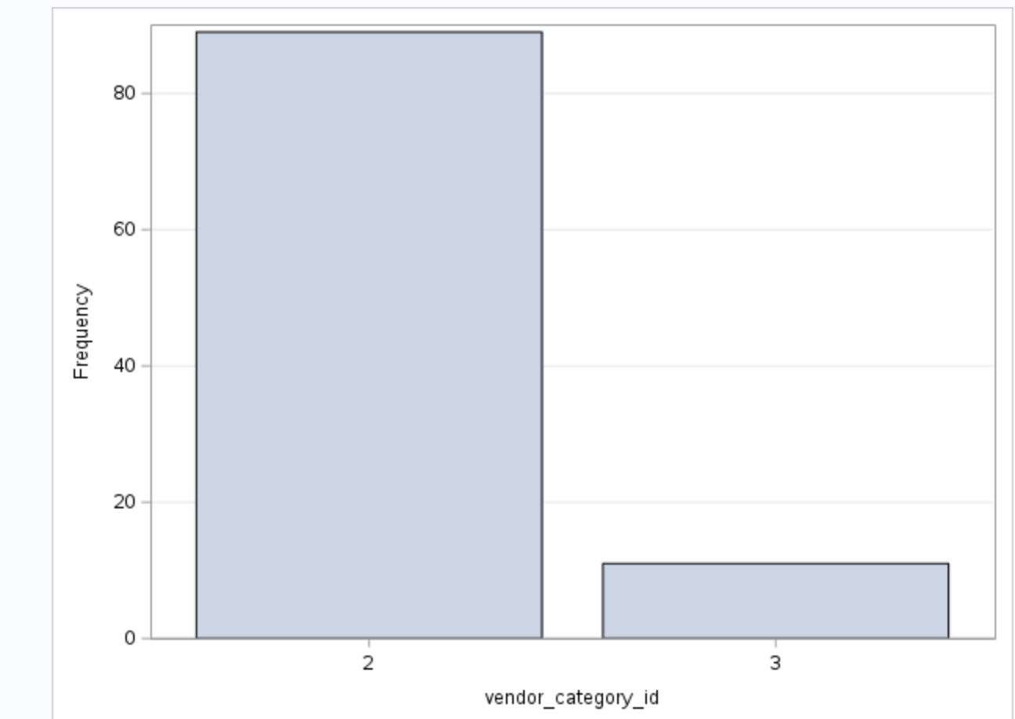
Frequency Vendor ID

Slide 5
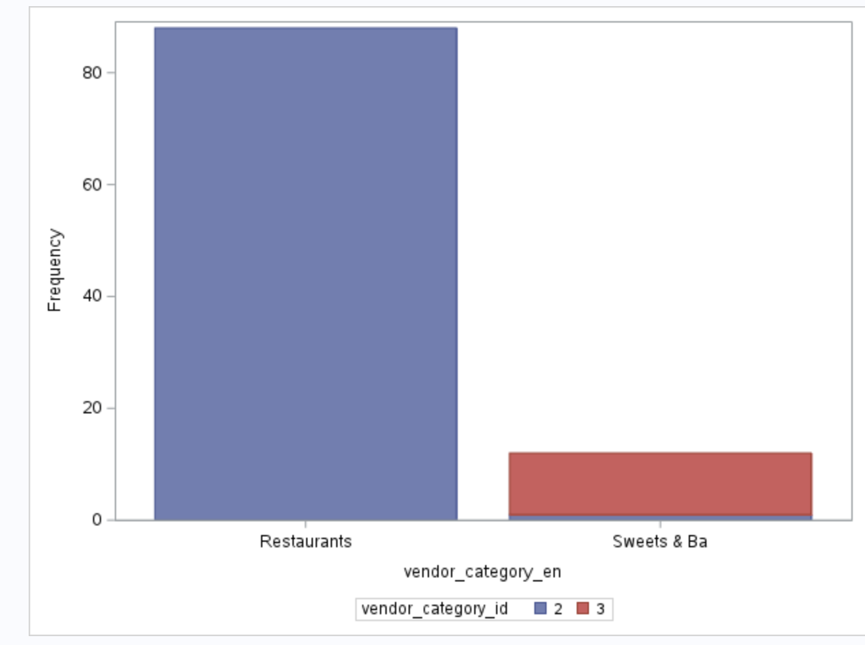
Vendor category count

Slide 6
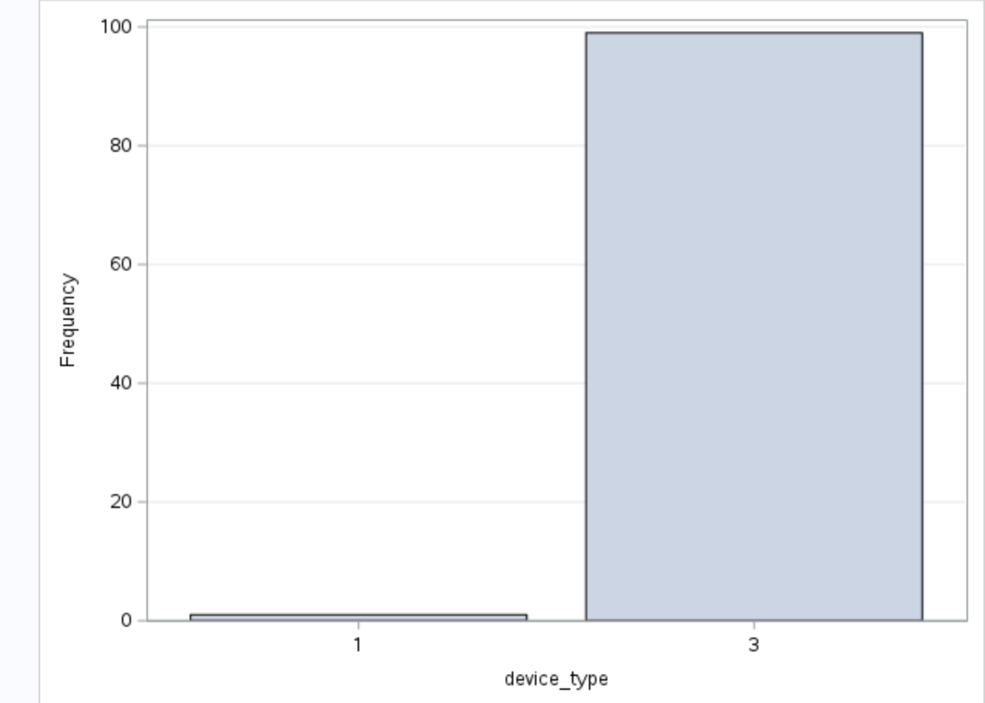
Device type Count

Slide 7
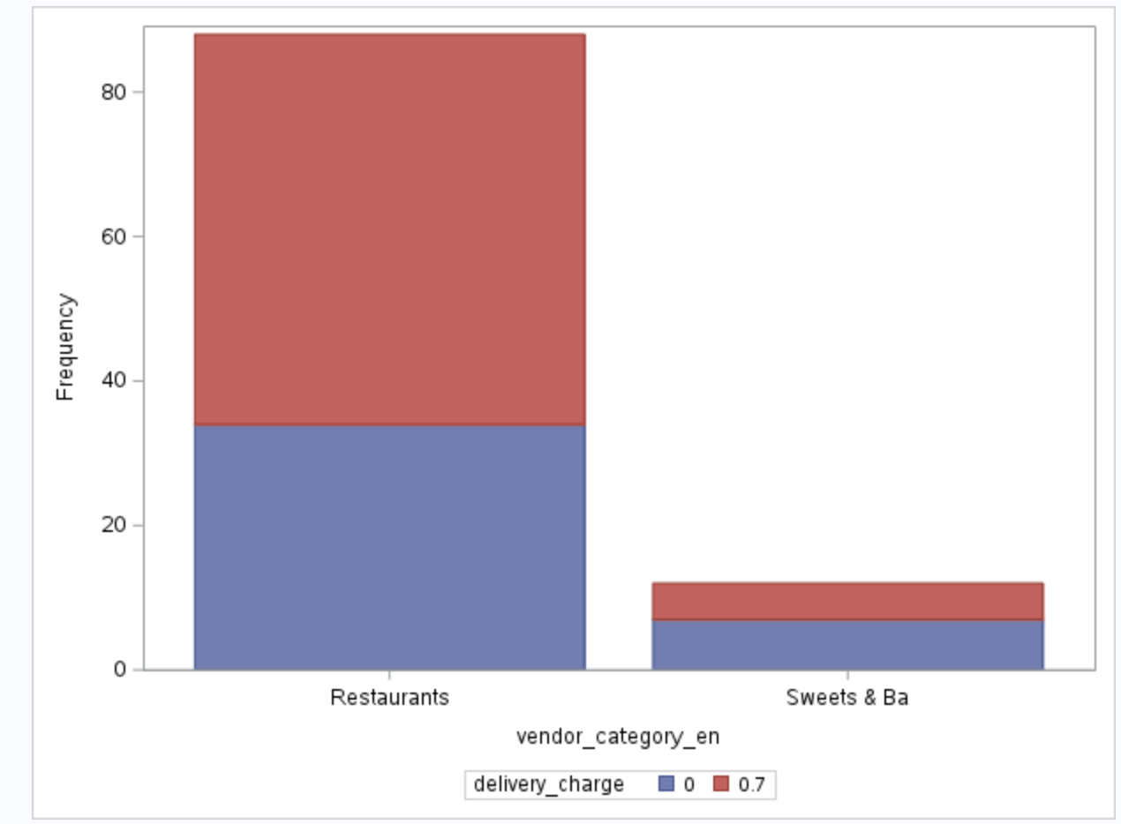
Delivery charge and Vendor category

Slide 8
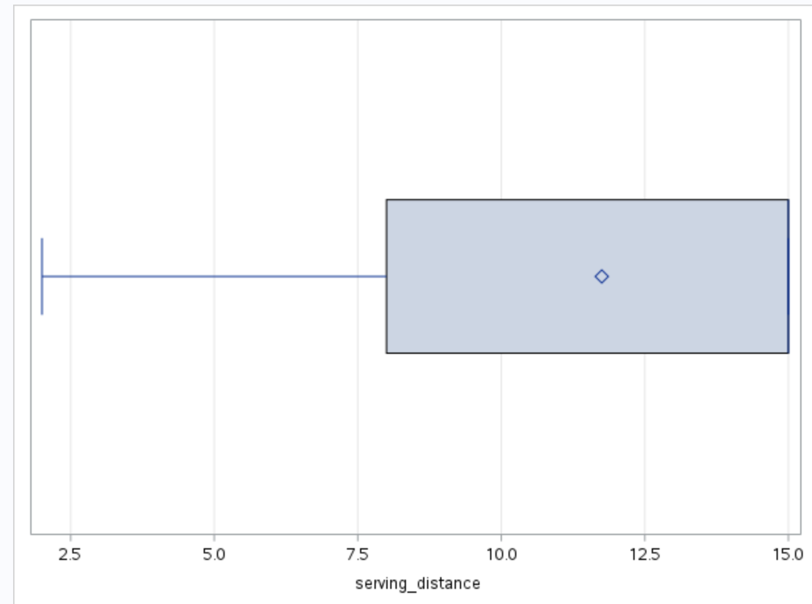
Distribution of Serving distance

Slide 9
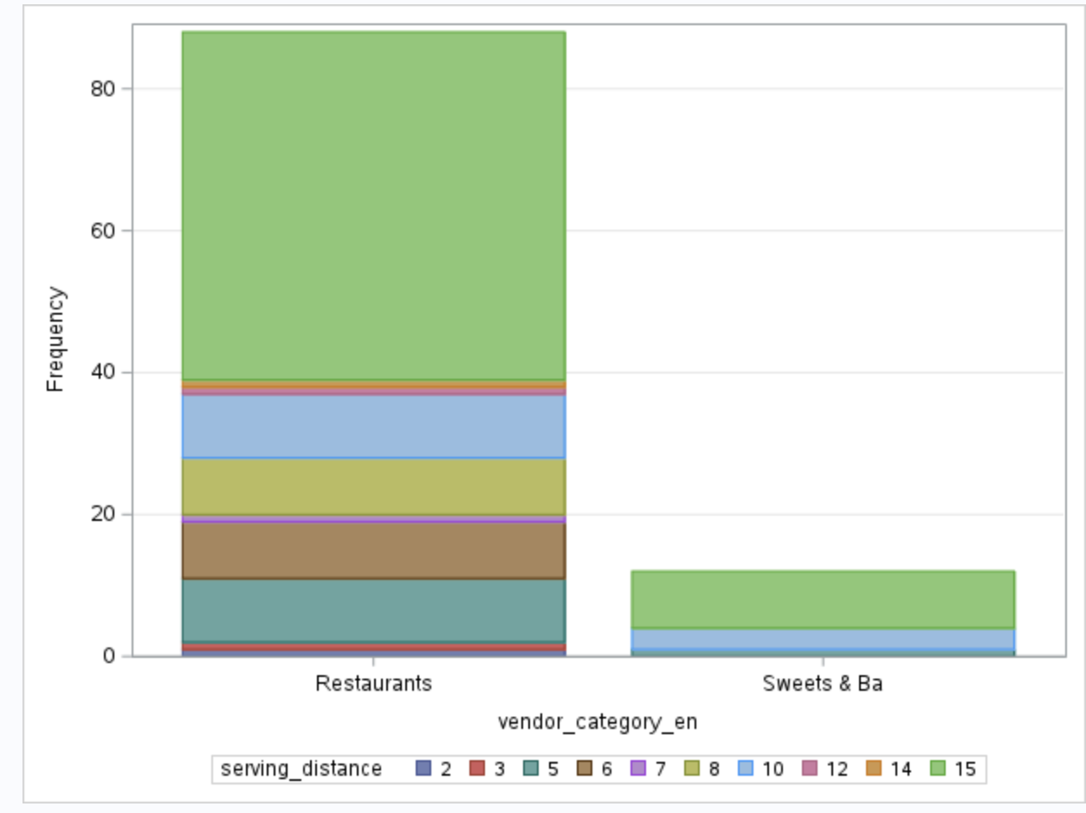
Vendor category with Serving distance

Slide 10
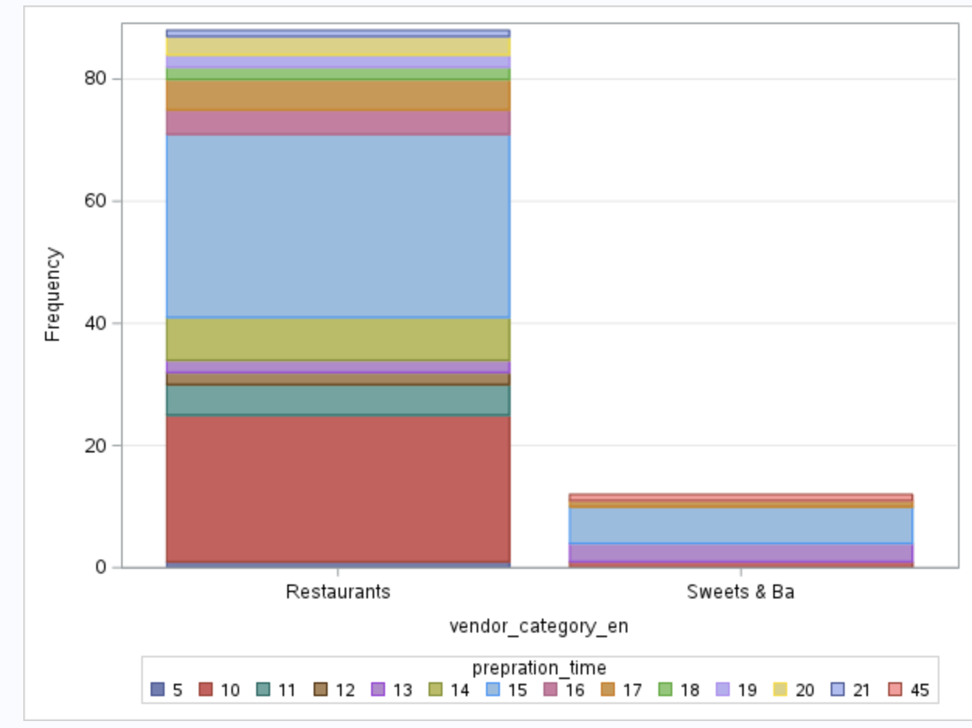
Vendor category with Preparation time

Slide 11
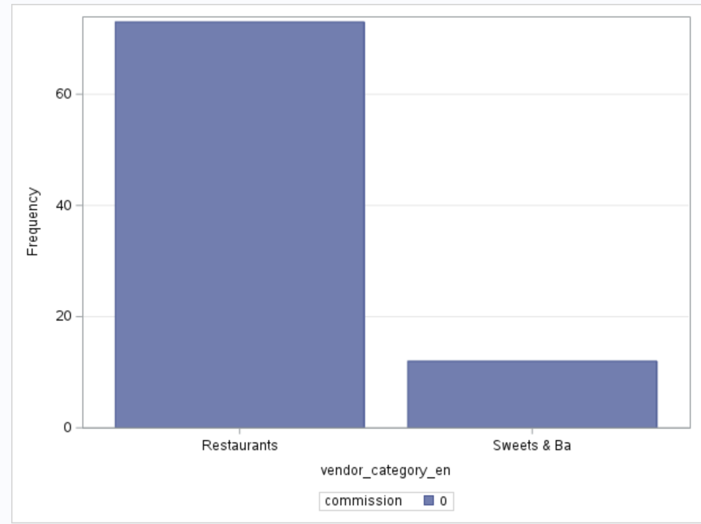
Vendor category with commission

Slide 12
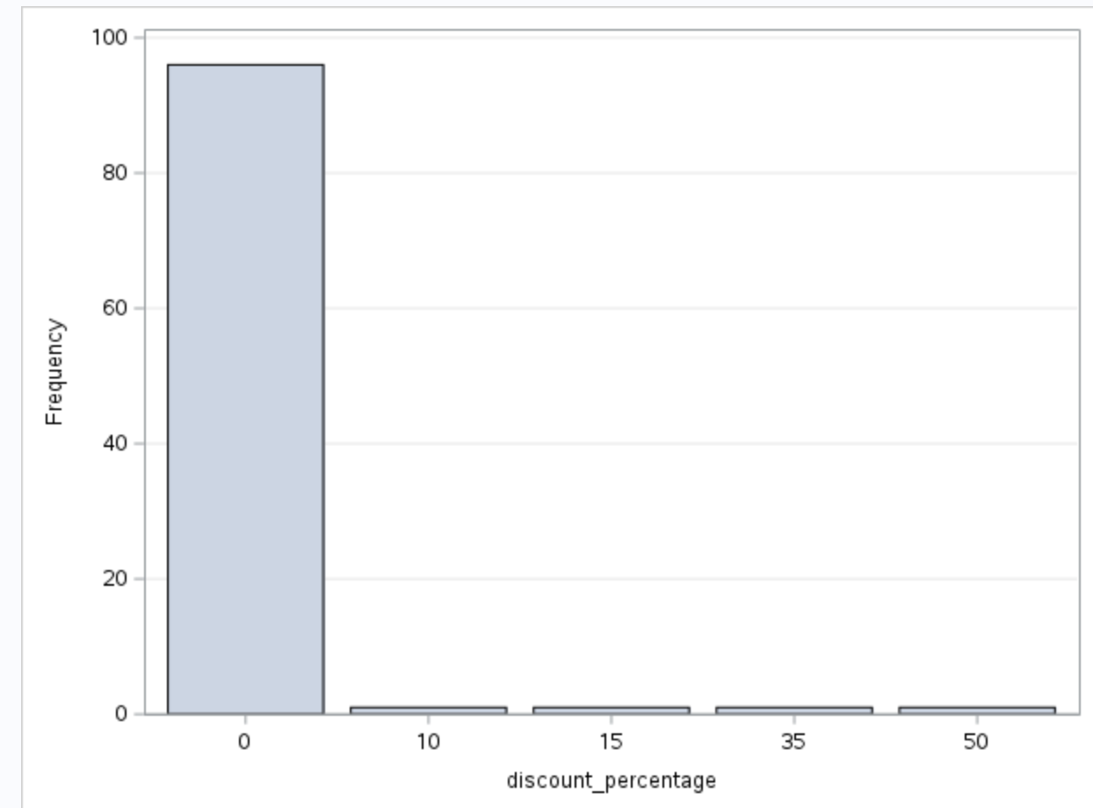
Discount percentage count

Slide 13
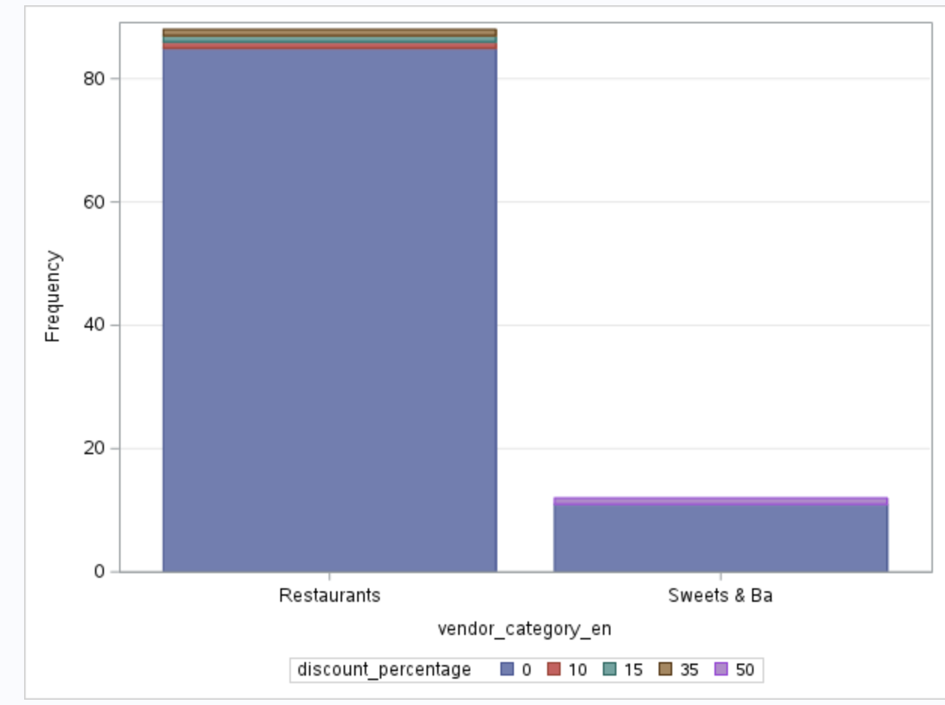
Vendor category with discount percentage

Slide 14
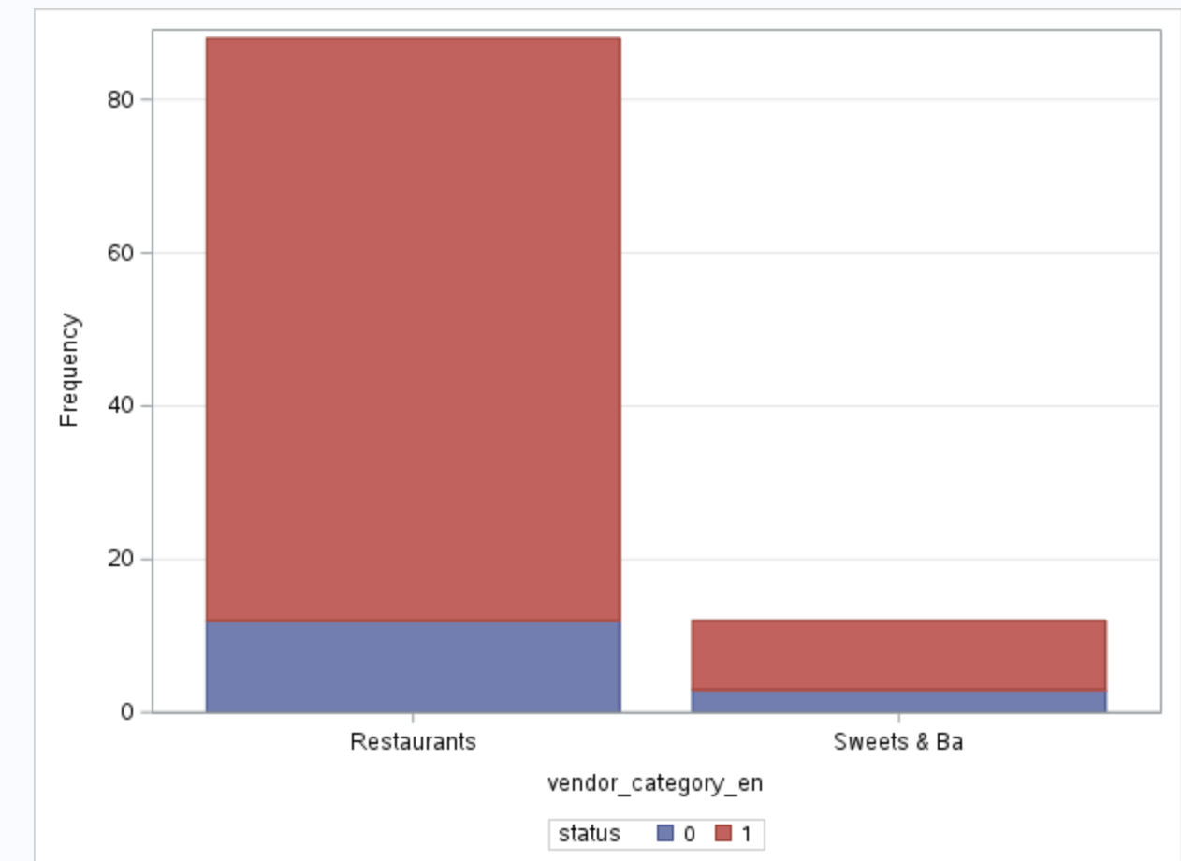
Vendor category with status

Slide 15

Vendor category with verified

Slide 16

Vendor category with rank

